Slide 1
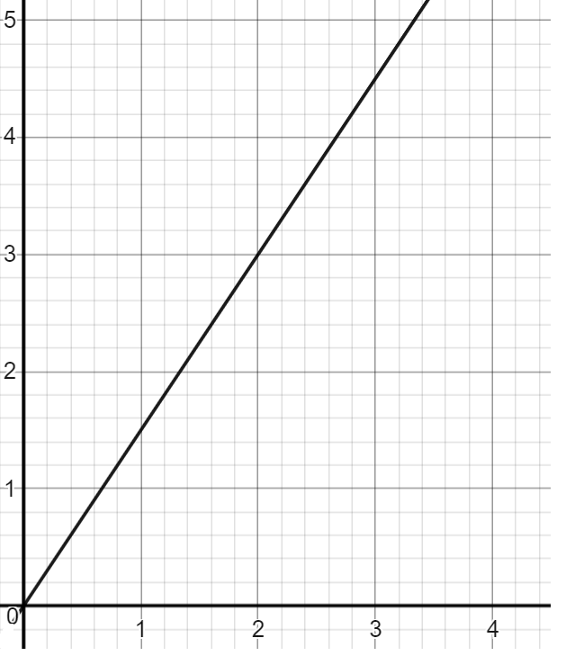
Ratio language and notation
Task A: Ratio language and notation
1) Fill in the table. The first has been done for you.
Bar model | Ratio notation | In words
 | Books : Hearts 3 : 1 | Ratio of books to hearts is 3 to 1
 | Squares : Circles 1 : 2 | Ratio of squares to circles is 1 to 2
 | T-shirts : Shorts 2 : 3 | Ratio of t-shirts to shorts is 2 to 3
 | Carrots : Apples : Oranges 1 : 2 : 2 | Ratio of carrots to apples to oranges is 1 to 2 to 2
B | B | B | H
⬛ | ⚫ | ⚫
T | T | S | S | S
C | A | A | O | O
2) All these represent the same ratio. Fill in the blanks.
£ | £ | $ | $ | $
$
£ | $
12 | 18
2
4
6
£
$
£ : $
2 : 3
3
6
9
£

Slide 2
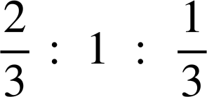
Ratio language and notation
Task A: Ratio language and notation
3) Match the ratio table with the ratio notation.
A | B
3 | 10
A | B
30 | 10
A | B
4 | 6
A | B
30 | 50
A | B
60 | 12
3 | 1
5 | 1
3 | 5
2 | 3
A : B
3 : 1
A : B
24 : 80
A : B
15 : 25
A : B
2 : 3
A : B
25 : 5
÷8
÷5
÷5
3 : 10
3 : 5
5 : 1
4) Work out the equivalent ratios.
8 : 10
20 : 25
× 2
× 5
2 : 2.5
÷ 2
4 : 5
× 8
0.4 : 0.5
÷ 10
÷ 4
32 : 40
1 : 1.25
5) Work out the equivalent ratios.
8 : 12 : 4
× 4
22 : 33 : 11
10 : 15 : 5
× 5
× 11
2 : 3 : 1
÷ 2
1 : 1.5 : 0.5
÷ 3
× 10
20 : 30 : 10
‹#›

Slide 3
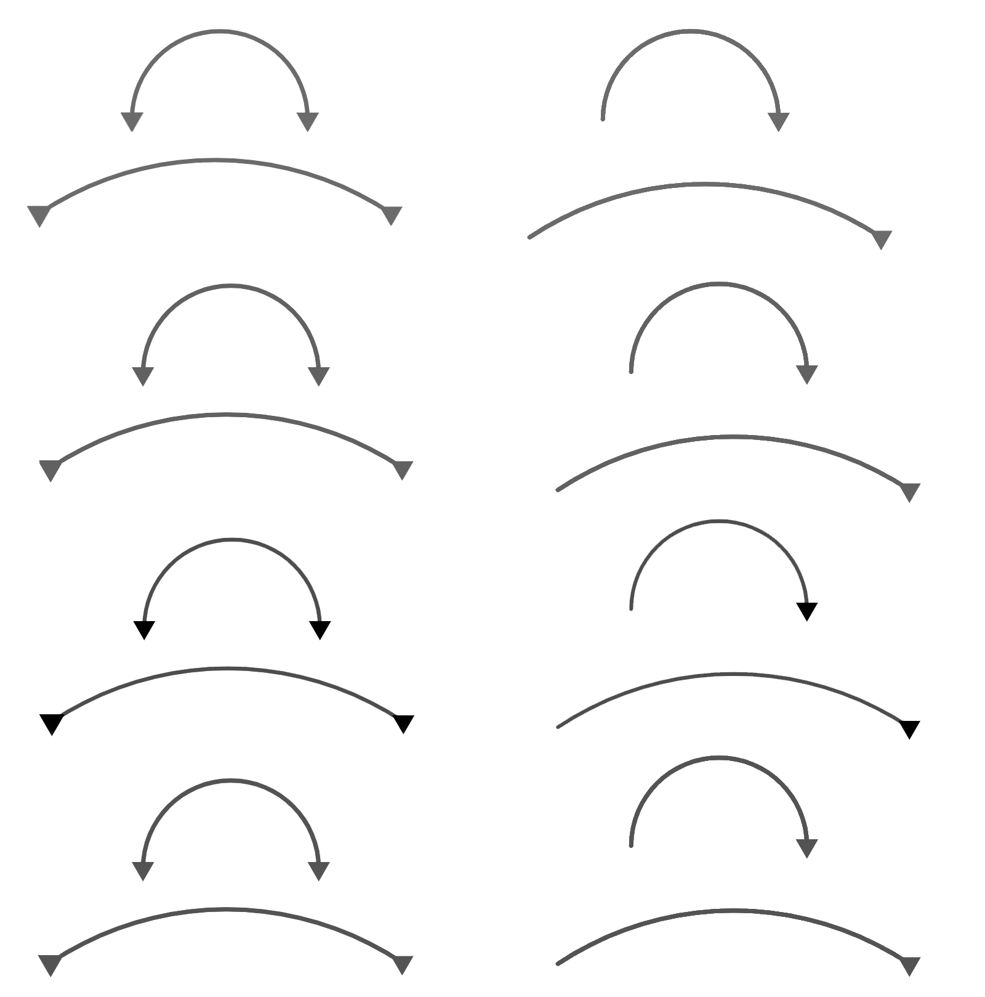

Ratio language and notation
Task B: Comparing different representations of ratio
1) Fill in the blanks to complete the work.
Cheese : Tomato
3 : 4
15 : 20
A total of 35 g means there is 15 g of cheese and 20 g of tomato.
b) Yoghurt : Strawberry
5 : 9
20 : 36
A total of 56 ml means there is 20 ml of yoghurt and 36 ml of strawberries.
c) Star : Tick : Stars
2 : 3 : 1
12 : 18 : 6
A total of 36 shapes means there are 12 stars, 18 ticks and 6 squares.
×5
×5
×4
×4
×6
×6
2) In a bag, there are only stars and circles.
The ratio of stars to circles is 2 : 3
a) If there are 20 stars, how many circles are there?
b) If there 65 shapes in total, how many stars are there?
stars : circles
2 : 3
20 : 30
× 10
×10
30 circles
stars : circles
2 : 3 total = 5
26 : 39 total = 65
× 13
×13
26 stars
‹#›

Slide 4

Ratio language and notation
Task B: Comparing different representations of ratio
3) The chocolates in this box either have red or blue wrappers.
The ratio of red to blue is 2 : 1
a) If there are 10 red chocolates, how many blue chocolates are there?
red : blue
2 : 1
10 : 5
×5
×5
There are 5 blue.
b) If there are 10 blue chocolates, how many red chocolates are there?
red : blue
2 : 1
20 : 10
×10
×10
There are 20 red.
c) Is it possible for there to be 10 chocolates in total? Why or why not?
No, as the total parts for chocolates is three. 10 is not a multiple of three. Every two red needs one blue, meaning that chocolates are ‘added’ in groups of three.
d) There are 10 more red chocolates than blue. How many are there in total?
red : blue
2 : 1
20 : 10
×10
×10
There are 20 red and 10 blue. This makes a difference of 10 chocolates between red and blue.
Mathematics in Education and Industry
‹#›
v2.3

